Slide 1
Achieving Fault-Tolerance on Cloud Computing
A Minimum Cost Flow Model for achieving Fault-Tolerance in Web Application on Cloud Computing

Slide 2
Introduction
Cloud Infrastructure providers allow Six types of virtual instance purchasing options to optimize operating cost based on specific computational needs.
These are - On-demand, Reserved, Scheduled, Spot, Dedicated Host and Dedicated Instances.
The ‘Spot Instance Pricing System’ was introduced by Amazon Web Services.
The cloud provider sets the price of the ‘Spot Instance’ (SP).

Slide 3
Introduction (contd.)
To use SP, a user needs to create a ‘Spot Fleet Request’ by including the maximum price they want to pay per hour per instance.
SP can reduce cloud infrastructure bills by 80% to 90% compared to On-Demand instances.
Our proposed auto-scaling mechanism uses a combination of SP and On-Demand Instance which not only reduces financial cost but also ensures a fault-tolerant application.
SP is ideal for availability and non-time-critical applications which requires massive computational capacity.

Slide 4
Objectives
To achieve a practical minimum-cost flow model for building a fault tolerant application in current cloud infrastructures using spared instance (spot instance in AWS).
Achieve automated Fault Tolerance (FT) in minimum Cloud Infrastructure Costs (FIC) compared with currently available semi-auto server solutions for the software systems.
A practical and fully fault tolerant software system which survives in extreme load test.
Automated Cloud Infrastructure (CI) which requires no or less human intervention once configured correctly.
Higher fault tolerance (FT) with less infrastructure costs (FIC) compared with current server solutions.

Slide 5
Related Works:
This section surveyed all the closely related state-of-the-artwork in the field of fault-tolerance using scaling of cloud resources. There are currently three main strategies for addressing fault tolerance by scaling cloud resources for software systems.
1. Cloud resource auto scaling (Reactive mechanism):
This approach does not consider the future needs. It is also often referred as threshold-based rule or elasticity rule which is pre-defined by the cloud infrastructure providers. The decision to scale up or scaling down the software system / server are determined by the last values that are monitored in the system. However, this auto scaling strategy is simple and convenient when system administrator can predict software system computational resource requirements well which is very difficult at times.

Slide 6
Related works (contd.)
2. Predictive based Cloud Resource Scaling Strategy:
Historical data of cloud computational resources are analyzed carefully to construct a mathematical scaling model to anticipate future demand of cloud computational resources by the software system.
3. Hybrid auto scaling mechanism:
This is a dynamic hybrid cloud resources scaling strategy that use reactive approach for scaling up and regression-based mechanism for scaling down.

Slide 7
Related Works(contd.)
Current best solutions in cost aware Auto scaling mechanism:
Zhang et al. (2016) , Kllapi et al. (2011) proposed an auto scaling schedule based framework where optimized time and cost of independent cloud workflow execution is considered. According to Zhang’s scaling strategy, types of multiple cloud resources and cloud configuration combined of those resources are given high priority when designing the auto-scaling mechanism.
Limitation: On-demand virtual instances are very expensive cloud computing resource. Auto-scaling with these instances based on traffic load / resource usage patterns incur huge costs.

Slide 8
Related Works (contd.)
Horizontal Approach of Auto-Scaling for Web Application:
Most of the research that has been carried out in cloud auto-scaling is relevant to ‘Horizontal Auto-Scaling’ strategies (“Autoscaling - Wikipedia”, n.d.). In AWS the user needs to create an auto-scaling group with cloud- formation instructions to identify which types of virtual machines and system images to use when auto-scaling new instances. Right Scale, a popular cloud service provider, scale applications based on a voting mechanism that allows all currently running virtual instances to vote whether to grow or shrink cluster sizes of the application depending on their own condition (Toosi, Khodadadi, & Buyya 2015). Cloud providers use proactive approach to comply with strict service level agreements (SLA) as it is important to provide computational resources before the workload is increased.

Slide 9
Related Works (contd.)
Most of the above research was aimed at maximizing provisioning of web applications using the least amount of cloud resources and homogeneous On-demand Instance (Aslanpour, Ghobaei-Arani, & Toosi, 2017), but no emphasis was placed on increasing fault-tolerance in web applications applying auto-scaling semantics and reducing the cost of heterogeneous SP.

Slide 10
Related Works (contd.)
Auto-Scaling Utilizing Spot Instance:
SP are generally used in a non-time-critical application context. There has been some research to utilize SP in non-availability critical application mostly in high performance computational processes, cloud data analytics, MapReduce and scientific experimental workflow. Researchers combinen multiple fault-tolerant mechanisms to increase the cost- efficiency and performance of batch processing using SP.

Slide 11
Main Features
A practical minimum-cost flow model for building a fault tolerant application in current cloud infrastructures using spared instance ( spot instance in AWS)
An automated Fault tolerance ( FT ) in minimum Cloud Infrastructure Costs (FIC) compared with currently available semi-auto server solutions for the software systems
A practical and fully fault tolerant software system which survives in extreme load test
Automated Cloud Infrastructure (CI) which requires no or less human intervention once configured correctly
Higher fault tolerance (FT) with less infrastructure costs (FIC) compared with current server solutions

Slide 12
Proposed Auto-Scaling System Model:
The proposed Auto-Scaling mechanism utilizes On-Demand and SP under an Elastic Load Balancer. Both, homogeneous instances (On-Demand VM) and heterogeneous instances (SP VM) have been incorporated into the Auto-Scaling group configurations. SP are 80 to 90% cheaper compared to On-Demand Instances.

Slide 13
Fault-Tolerance Strategy
If the demand for the certain type of the SP rises, the price of that particular SP’s VM also goes up
If the entire application system uses just one SP or one type of SP, we need to scale up 100% computational capacity to retain availability of the system
This strategy will configure the system so that multiple types of SP can be used
if the demand for particular types of SP goes up, it does not impact the fault-tolerance of the system

Slide 14
Reliability and Cost Efficiency of proposed model
Default Fault Tolerance level
On-Demand Instance Percentage
Total Cost
Scaling Up Algorithm
Spot Instance Bidding Price Algorithm
Scaling Down of On-Demand Instance Algorithm

Slide 15
Real-time data from AWS
1. Current prices of the spare spot instances through Spot Instances
2. Instances termination event through Spot Fleet API.
3. Our current application load/ traffic usages from Cloudwatch monitoring system.
4. Hardware resources utilisation level (like 67% cpu usage, 80% memory usage) of any particular instance using Cloudwatch system.
5. Price prediction graph for Spot Instances
Publicly available datasets: Link to AWS Spot Instance Pricing History from Kaggle:
https://www.kaggle.com/noqcks/aws-spot-pricing-market

Slide 16
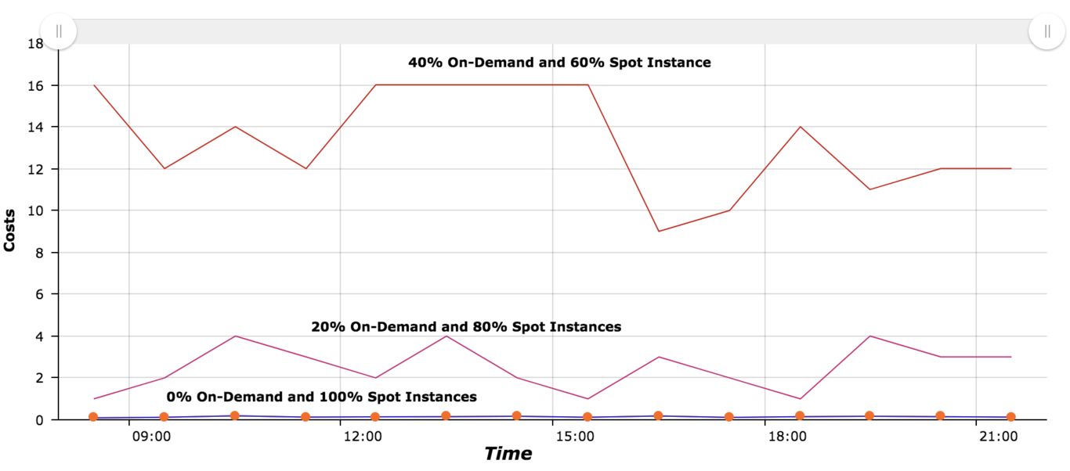
Costs comparison between different combination of On-Demand and Spot Instance usage

Slide 17
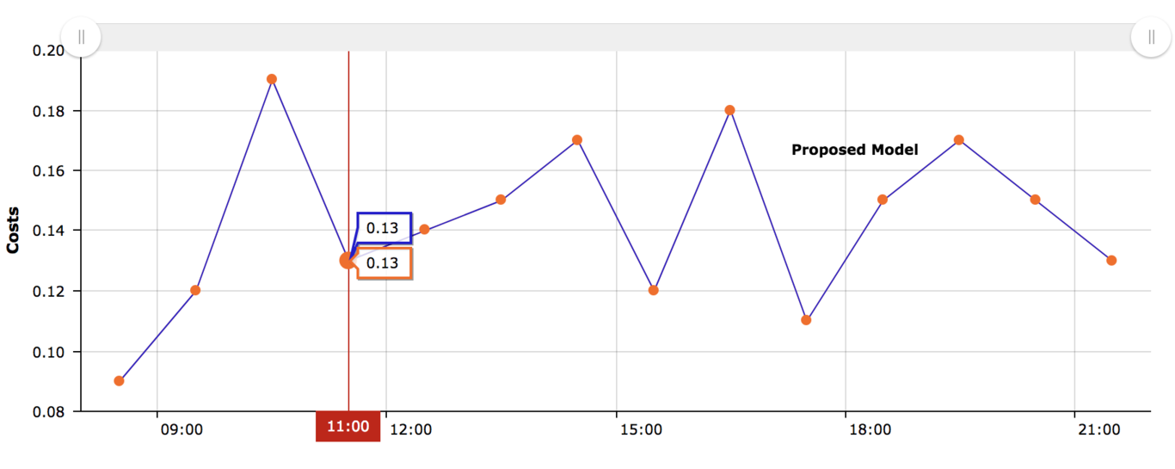
Hourly costs in USD of a sample fault-tolerant web application using our proposed model (Tested in AWS, Feb 02 2018)

Slide 18
Business Model
We are expecting a lot from this project. For business purpose this model will be beneficial. We are expecting to include this model in Bitcoin and in share markets. This will stop those servers from getting down and this will keep the users active. The users can access to their servers anytime they want to do their tasks. Our model will increase the customer satisfaction and thus this will be a helpful stuff to use which the customers will be getting in low price.

Slide 19
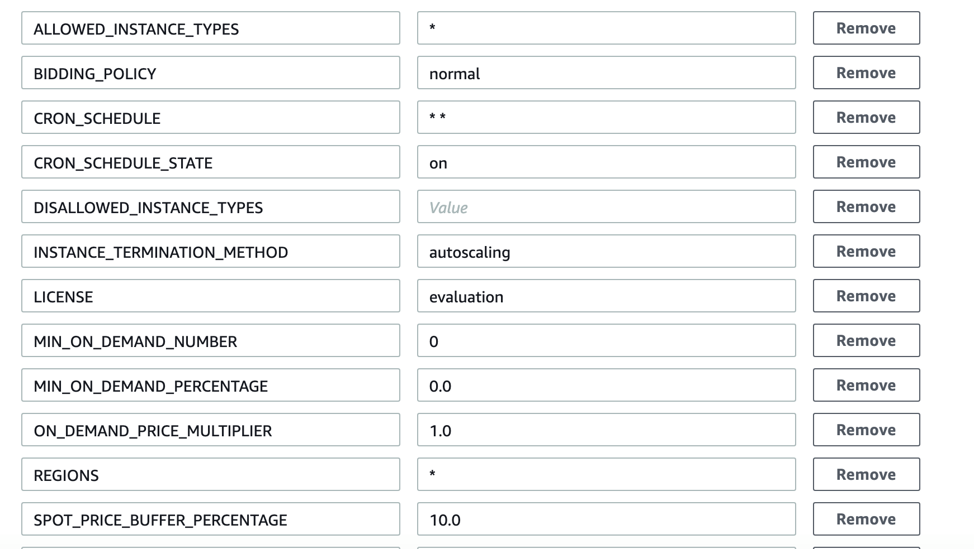
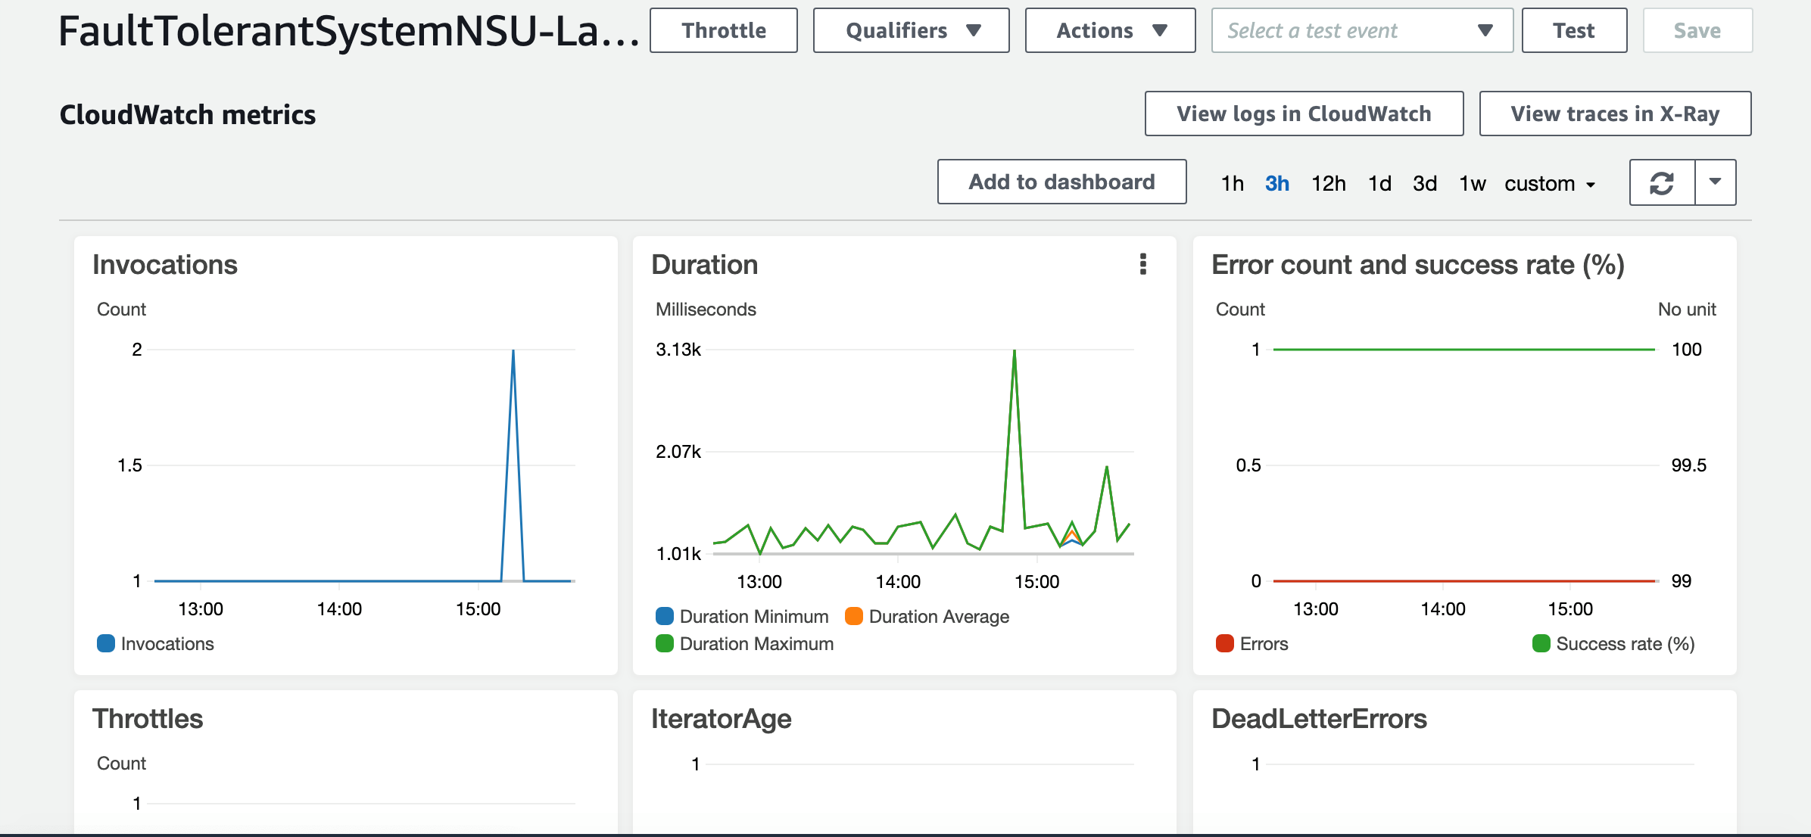

Slide 20
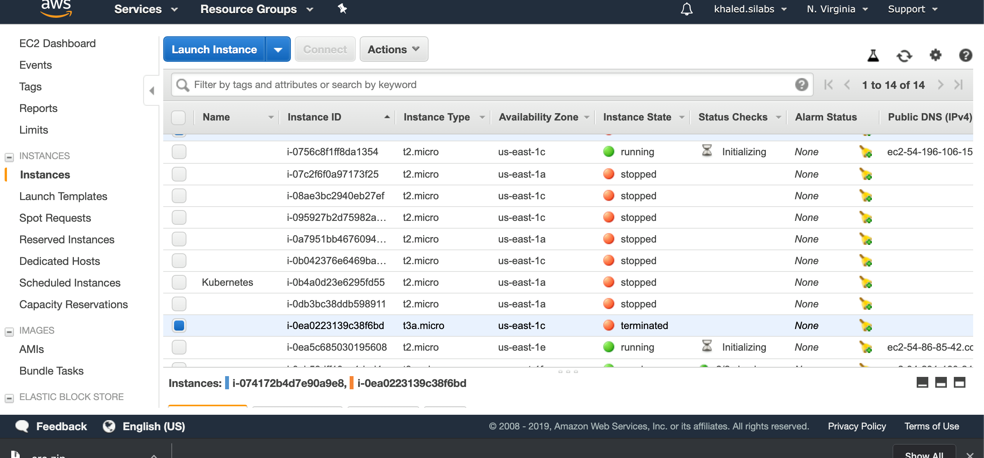
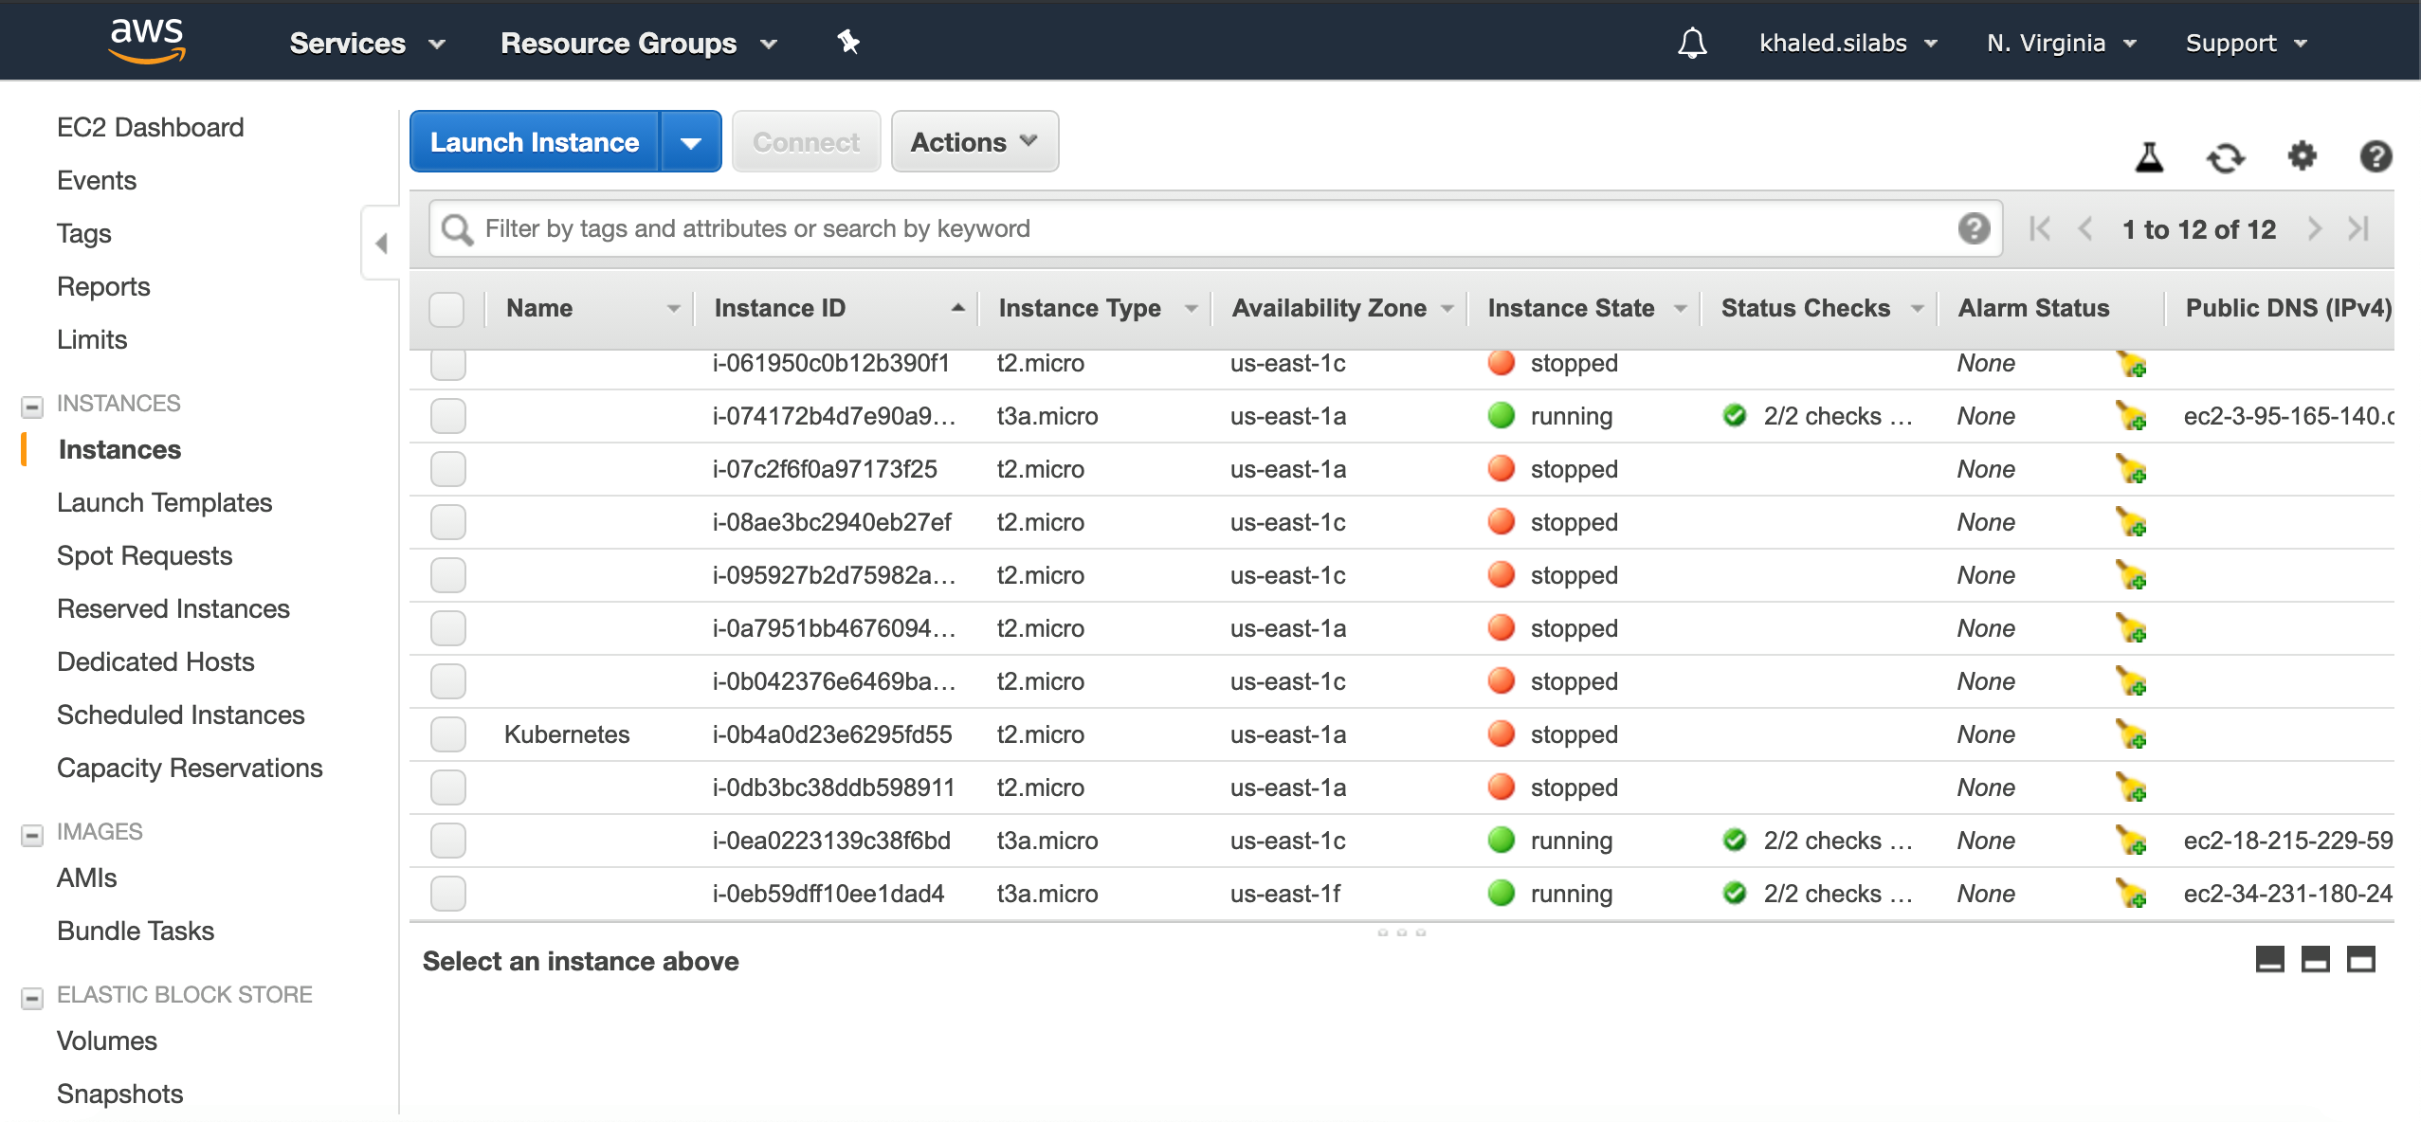

Slide 21
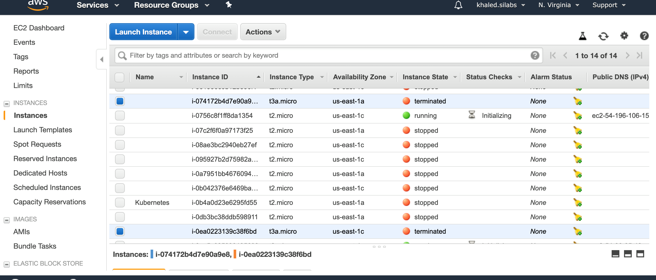
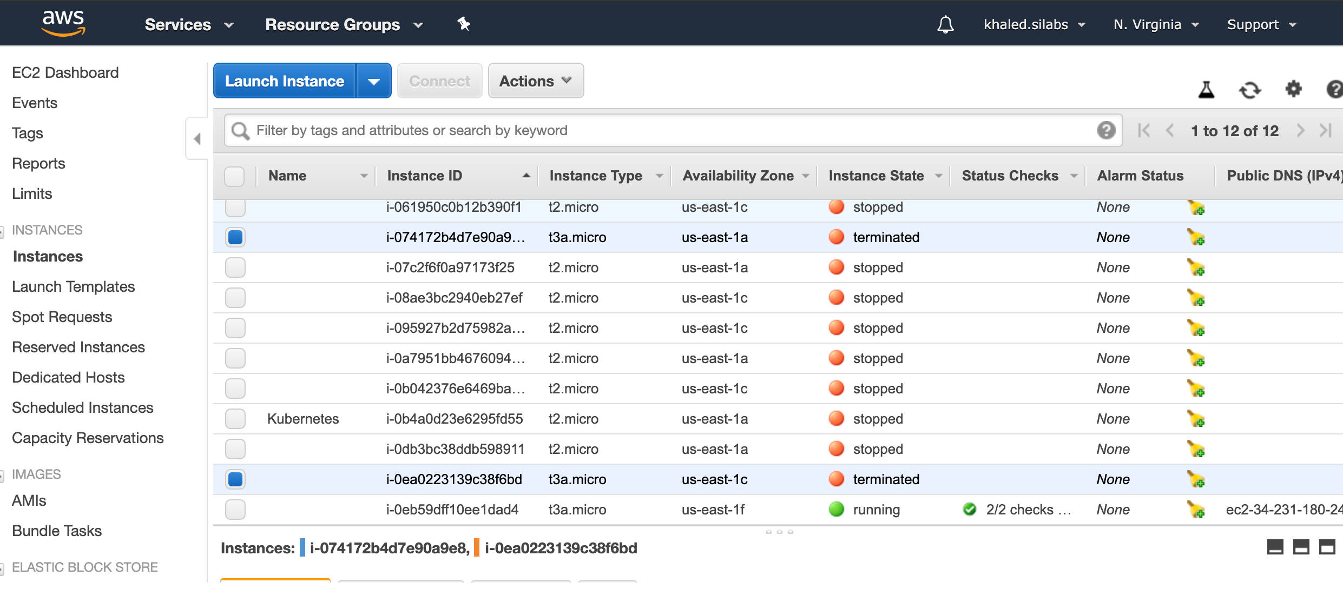

Slide 22
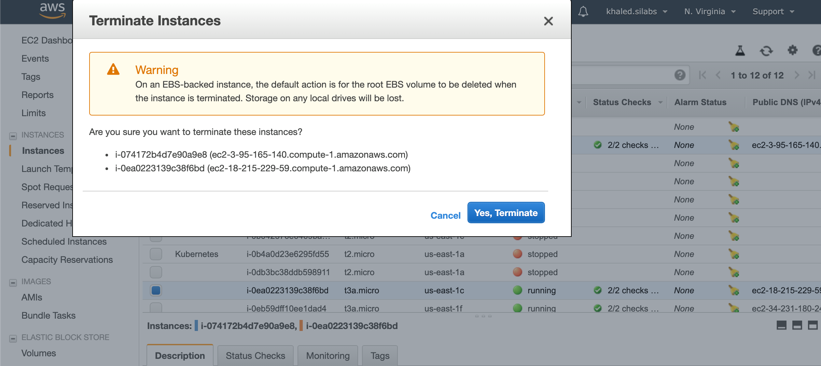
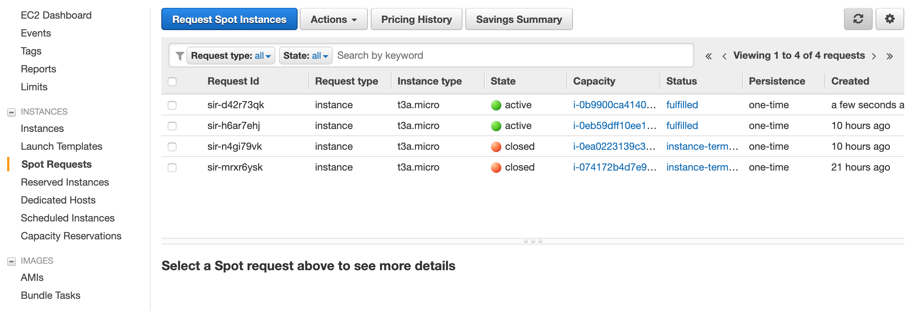

Slide 23
Thanks

